Slide 1
WEB HAZARD & INFRASTRUCTURE SCANNING THROUGH AUTOMATED PENTESTING AND REPORTING
Author: Samuel Vázquez Morón

Slide 2
Outline
Introduction
Objectives
Implementation
Integration
Conclusions

Slide 3
Introduction
Motivation
Internet of Things, globalization
In 2015, 24% of security professionals suffered a data or system breach
Half of these breaches exceeded 450,000 € in losses
Insufficient awareness about web security

Slide 4
Introduction
Pen-testing
Authorized simulated attack
Finds vulnerabilities like an attacker would
Tests a company’s security policies
Expensive (3,500€ ~ 18,000€)
45% of security professionals don’t perform pen-testing regularly, 8% never do

Slide 5
Introduction
Why focus on web applications?
Constantly exposed to the Internet
Commonly hold important / sensitive information
Relatively easy to attack
Many different vectors of attacks exist – Difficult to protect
35% increase in web attacks from 2016 to 2017

Slide 6
Objectives
Vulnerability Scanner:
Find common vulnerabilities
Offer a set of recommendations
Pen-testing sales pitch
Raise awareness about web security

Slide 7
Implementation
Information gathering
Automated testing
Report generation
Three stages:
Information gathering
Automated testing
Report generation

Slide 8
Implementation
Information gathering
Automated testing
Report generation
Interface scan
Network scan
Port scan
Interface scan
Find what network to scan
Output in CIDR format (e.g.: 192.168.0.0/16)

Slide 9
Implementation
Information gathering
Automated testing
Report generation
Interface scan
Network scan
Port scan
Network scan
Find live hosts with Nmap
Output all IPs that respond to a ping

Slide 10
Implementation
Information gathering
Automated testing
Report generation
Interface scan
Network scan
Port scan
Port scan
Find ports that might hold web apps with Nmap
Output in URL format

Slide 11
Implementation
Information gathering
Automated testing
Report generation
Spider + Passive scan
Active scan
Use OWASP ZAP
Spider: Bot that fetches children pages

Slide 12
Implementation
Information gathering
Automated testing
Report generation
Spider + Passive scan
Active scan
Passive scan in parallel to spider
Checklist-like vulnerability detection

Slide 13
Implementation
Information gathering
Automated testing
Report generation
Spider + Passive scan
Active scan
Active scan: apply 15 different payloads (attacks)
Verify whether each attack is successful

Slide 14
Implementation
Information gathering
Automated testing
Report generation
Gather variables
Create report (pdf) via GitBook / Jinja2

Slide 15
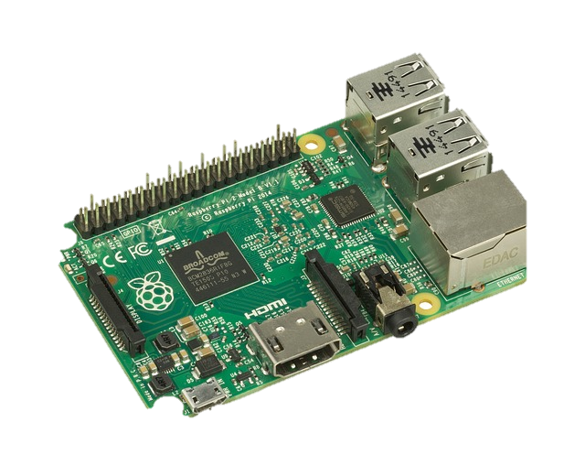
Integration
How to use it?
Raspberry Pi

Slide 16
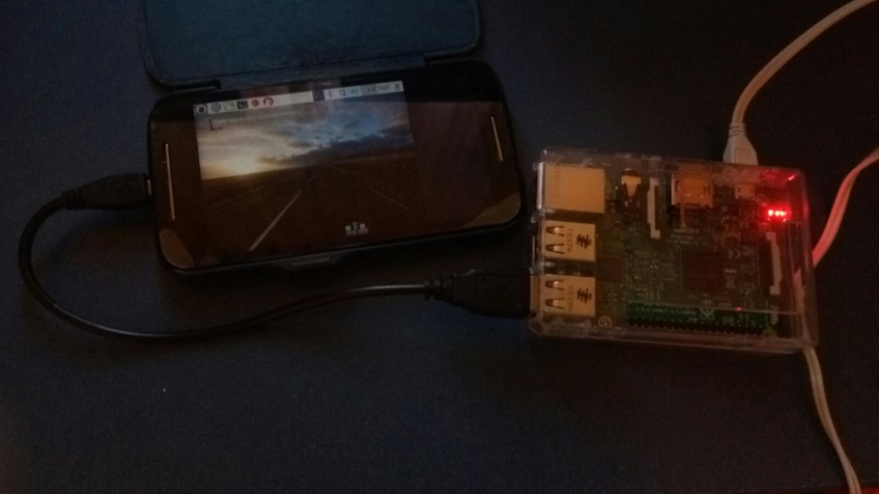
Integration
How to use it?
VNC (Virtual Network Computing)
USB connection

Slide 17
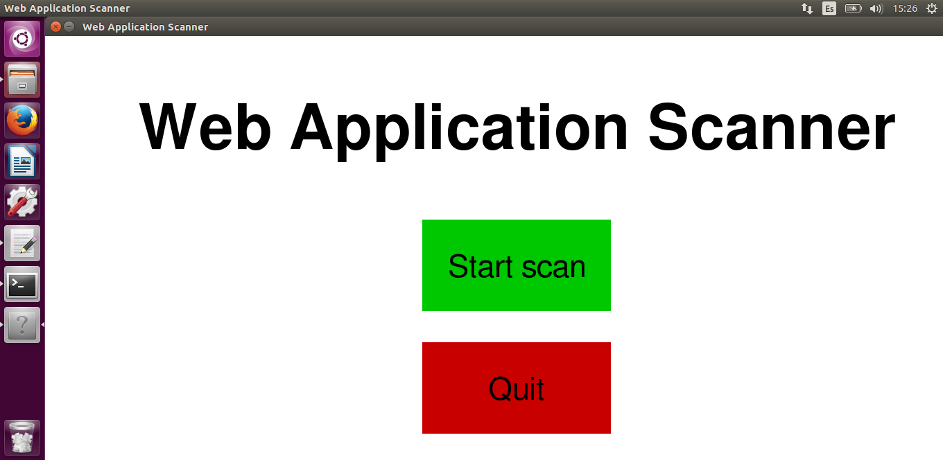
Integration
How to use it?
Graphical User Interface (Pygame)

Slide 18
Conclusions
Not a substitute for a proper pen-testing
Some vulnerabilities can’t be detected
Full invulnerability is unachievable
Regular audits remain the safest measure

Slide 19
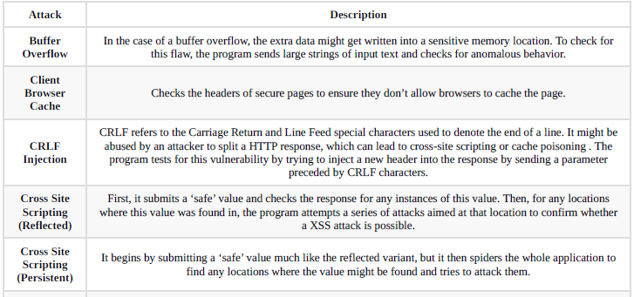
Web Application Attacks
Web Application Attacks (Active scan)

Slide 20
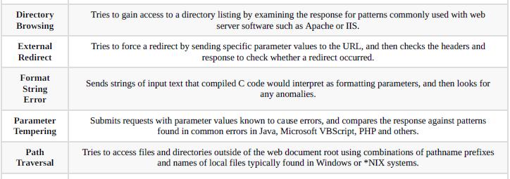
Web Application Attacks
Web Application Attacks (Active scan)

Slide 21
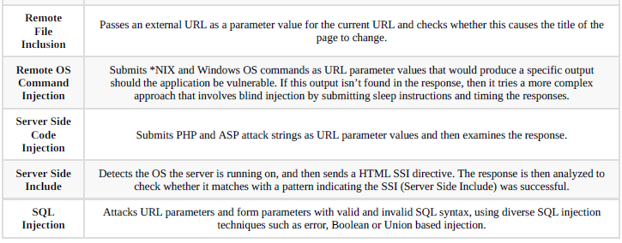
Web Application Attacks
Web Application Attacks (Active scan)

Slide 22
Web Application Attacks
SQL Injection
Interpreters (SQL, OS, etc) normally receive user data as part of a command. This dynamically constructs a SQL query (normal usage)
With some ingenuity, this can be abused to construct arbitrary SQL queries

Slide 23
Web Application Attacks
SQL Injection (example)
accounts
ID | Username | Password
1 | admin | adminpass
2 | user2 | pass2
3 | user3 | pass3
Normal usage:
Username | admin | Password | adminpass

Slide 24
Web Application Attacks
SQL Injection (example)
accounts
ID | Username | Password
1 | admin | adminpass
2 | user2 | pass2
3 | user3 | pass3
SQL Injection:
Username | admin’ -- | Password

Slide 25
Web Application Attacks
XSS (Cross-Site Scripting)
If a web application accepts input that is then used to generate the output → That input can be abused to generate an arbitrary output

Slide 26
Web Application Attacks
Stored XSS
Stored XSS (Type-I): Malicious input saved into a database, message forum or similar. Any user accessing that information will be affected

Slide 27
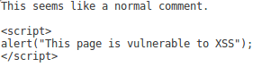
Web Application Attacks
Stored XSS
Example (message forum):
Message with malicious script is posted
Whenever a user accesses the page their browser runs the script, since the browser cannot distinguish it from genuine browser content

Slide 28
Web Application Attacks
Reflected XSS
Reflected XSS (Type-II): Malicious input generates a server response (error message, search result, etc). Link is then sent to the victim to lure them into clicking

Slide 29
Web Application Attacks
Reflected XSS
Example (search engine):
Looking up:
Returns the URL:
Looking up:
Returns the URL:
Social engineering is then used to send the link
xss
…/search?q=xss
<script>alert("XSS")</script>
…/search?q=<script>alert("XSS")</script>

Slide 30
Report Generation
Report Template
Introduction
Executive Summary
Summary of Results
Attack Narrative
Risk Rating
Recommendations
Appendix: Methodology

Slide 31
Report Generation
Generation process
Create “book.json” file via Python
GitBook has files corresponding to every section of the report (written in Jinja2)
GitBook takes the “book.json” file and uses it to create the final file (pdf)

